Slide 1
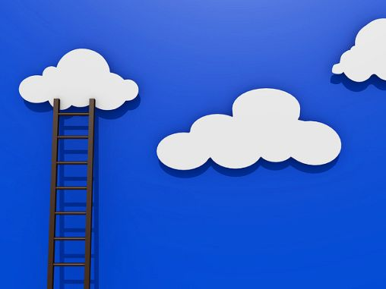

VIRTUALIZATION & CLOUD COMPUTING
Lecture #1-2
CSE 423
Virtualization Technology

Slide 2
Move to Virtualization..
Datacenters around the world are looking to virtualization technologies to reduce their carbon footprint.
Less server utilization, power, storage and cooling.
Virtualization promises server hardware usage ratios of 80 percent or more while delivering the same workloads on a much smaller hardware, and therefore carbon footprint.

Slide 3
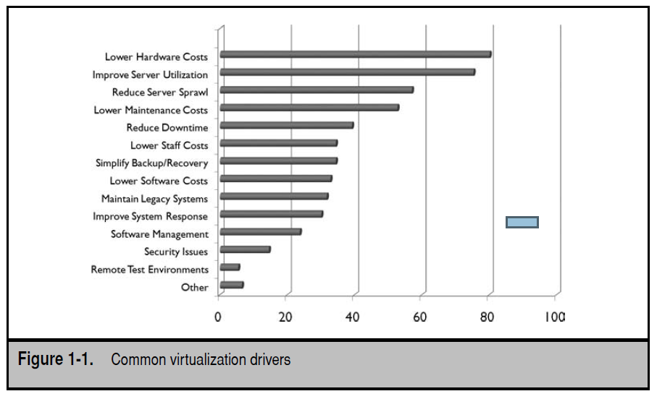
Move to Virtualization..

Slide 4
Before You Begin..
With the rising cost of energy, more and more organizations feel the need to move to a greener datacenter, one that will use a reduced amount of space and a reduced amount of energy and cooling to host a smaller number of physical servers.
this can be achieved through the use of virtualization technologies within the datacenter at server, workstation, and application levels.

Slide 5
STEP ONE: DISCOVERY
The first step, Discovery, lets you identify what is in your organization’s network and gives you a view of how it could be transformed.
How can you move to virtualization if you don’t know how many servers you are running and what their purpose in your network is?

Slide 6
We know that the reason most IT administrators are looking to server virtualization is because of the datacenter crunch. There is no more room in today’s datacenters.
Adding more servers always requires more power input as well as more cooling. Datacenter upgrades are expensive.
physical servers are hard to provision : acquisition cost and less utilization

Slide 7
One of the easiest ways to generate an inventory of your network is to work with free tools.
For example, many people use the Microsoft Baseline Security Analyzer (MBSA) to scan their networks for vulnerabilities and required updates. MBSA is easy to set up and run against all of the systems in your infrastructure.
Once a scan is complete, MBSA provides you with information on each system it scanned, including Internet Protocol (IP) address, operating system, installed applications, and, of course, vulnerabilities.
You can easily turn this valuable data into an inventory by linking the results of any MBSA scan with Microsoft Visio through the Microsoft Visio Connector for MBSA.
Visio will automatically generate a graphic image of your network and display detailed information on each device when you click on it.

Slide 8
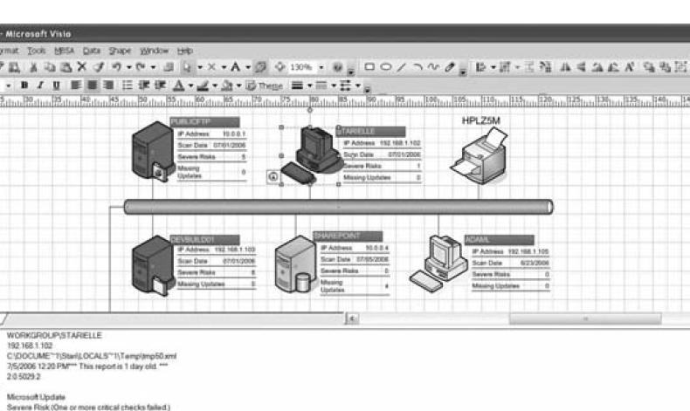

Slide 9
STEP 2: VIRTUALIZATION
After gathering information about systems, we can move on to step 2 and begin to learn about the different virtualization technologies and how they can help solve specific business issues in our organization.
Virtualization : The ability to run multiple virtual machines on top of a single physical machine
Everything depends on what is available on the real machine: hard disk space, processor capability, network interface cards, and amount of random access memory (RAM).
The virtual machines you create with virtualization software can support the installation and operation of any number of operating systems

Slide 10
It is important to fully understand which types of virtualization are available
In a dynamic datacenter—one that takes full advantage of the value propositions of virtualization—there will be at least seven layers of virtualization:
Server Virtualization (SerV)
Storage Virtualization (StoreV)
Network Virtualization (NetV)
Management Virtualization (ManageV)
Desktop Virtualization (DeskV)
Presentation Virtualization (PresentV)
Application Virtualization (AppV)

Slide 11
(1) Server Virtualization (SerV)
It is focused on partitioning a physical instance of an operating system into a virtual instance or virtual machine.
Major Server Virtualization vendors:
Citrix, Microsoft, VMware
True server virtualization products will let you virtualize any x86 or x64 operating system, such as Windows, Linux, and some forms of UNIX. There are two aspects of server virtualization:
Software Virtualization (SoftV)
Hardware Virtualization (HardV)

Slide 12
Contd..
Software Virtualization (SoftV) runs the virtualize operating system on top of a software virtualization platform running on an existing operating system. Ex. Type 2 Hypervisor like Vmware Workstation or Virtual Box
Hardware Virtualization (HardV) runs the virtualized operating system on top of a software platform running directly on top of the hardware without an existing operating system.
The engine used to run hardware virtualization is usually referred to as a hypervisor (actually Native /Type 1 hypervisor). The purpose of this engine is to expose hardware resources to the virtualized operating systems. Ex.Oracle VM Server, Citrix XenServer

Slide 13
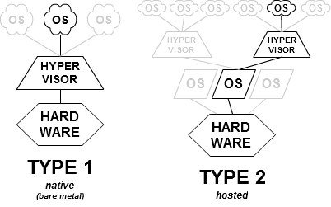

Slide 14
(2) Storage Virtualization (StoreV)
It is used to merge physical storage from multiple devices so that they appear as one single storage pool.
Advantage :
Non Disruptive data Migration.
Improved Utilization :
  Since pooled storage admin no longer search for disk with free space to allocate to host
  Thin provisioning allows assignation of a logical unit (LU) of storage of a given size, but provisioning it only on an as-needed basis.

Slide 15
(3) Network Virtualization (NetV)
It lets you control available bandwidth by splitting it into independent channels that can be assigned to specific resources.
For example, the simplest form of network virtualization is the Virtual Local Area Network (VLAN), which creates a logical segregation of a physical network.
In addition, server virtualization products support the creation of virtual network layers within the product itself

Slide 16

(4) Management Virtualization (ManageV)
It is focused on the technologies that manage the entire datacenter, both physical and virtual, to present one single unified infrastructure for the provision of services.
Two key layers are segregated at all times:
Resource Pools (RP), which includes the collection of hardware resources— host servers, racks, enclosures, storage, and network hardware—that makes up the datacenter infrastructure
Virtual Services Offerings (VSO), or workloads that are made up of the virtual machines—servers and/or desktops—that are client-facing and offer services to end users

Slide 17
(5) Desktop Virtualization (DeskV)
Desktop virtualization moves desktop computing to virtual machines hosted on servers.
allows you to rely on virtual machines to provision desktop systems.

Slide 18
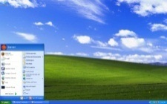
Virtualization is all about layers of abstraction
Key Definitions for Desktop Virtualization
A desktop computer is comprised of four system layers:
Physical Machine | The processor, memory, and storage that sits on the desk.
Operating System | Typically Microsoft Windows but could also be a desktop Linux variant or the Mac OS.
Applications | Such as an e-mail client, word processor, spreadsheet, or enterprise application client (example: client side application for a CRM system).
Presentation | The user interface including what is presented on the desktop monitor and interacted with via input devices (keyboard, mouse).
Presentation Layer
Virtualization inserts a layer of abstraction between system layers. The system layer above interacts with an abstraction rather than something “real”.
Example: In presentation virtualization (such as Terminal Services) the user interacts with a presentation of an application on their desktop. But the “real” application, OS, and physical layers behind the presentation are not on the desktop but on a server located somewhere else.

Slide 19
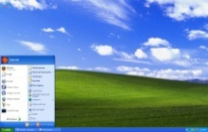
Different abstractions for different kinds of virtualization
Key Definitions for Desktop Virtualization
Presentation Virtualization
In traditional remote access of server based applications, (Citrix Presentation Server, Microsoft Terminal Services) only presentation layer virtualization is used.
Presentation virtualization is also used for remote access of workstation hardware.
Application Virtualization
In application virtualization, an application can be downloaded and run locally without special configuration of either the application or the client PC or its OS. The application interacts with an abstraction layer between it and the OS and machine layers.
Examples of application virtualization solutions include VMware View (ThinView), Citrix XenApp, and Microsoft App-V.
Desktop Virtualization
Desktop Virtualization uses both a Machine Virtualization layer for hosting PC VMs on a server and presentation virtualization for remote access of those virtual machines from the desktop.
Presentation Layer

Slide 20
(6) Presentation Virtualization (PresentV)
Until recently called Terminal services
provides only the presentation layer from a central location to users
The need for PresentV is diminishing because of the introduction of technologies such as Application Virtualization

Slide 21
(7) Application Virtualization (AppV)
uses the same principles as software based SerV, but instead of providing an engine to run an entire operating system, AppV decouples productivity applications from the operating system.
Application virtualization layers replace part of the runtime environment normally provided by the operating system. The layer intercepts all file and Registry operations of virtualized applications and transparently redirects them to a virtualized location, often a single file

Slide 22
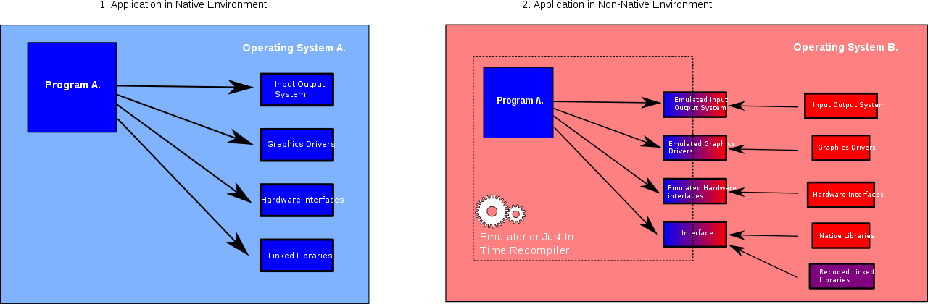

Slide 24
Contd..
Key terms in the language of virtualization in the datacenters includes:
Host server The physical server running virtual machine workloads.
Guest operation system A virtualized operating system running as a workload on a host server.
Resource Pool The collection of hardware resources, including host servers that make up the datacenter infrastructure.
Virtual Service Offerings The virtual machines that are client-facing and offer services to end users. They are also often referred to as virtual workloads.

Slide 25
What Is a Virtual Machine?
Virtualization advantage is that you can take a physical server that is running at 10 percent utilization and transform it into one running at 60 to 80 percent utilization by loading it up with multiple virtual machines
VMs are then made up of several different components:
Configuration file :
Hard disk file
In-memory file
Virtual machine state file
Other file

Slide 26
What Is a Virtual Machine?
Configuration file :
A file that contains the settings information—amount of RAM, number of processors, number and type of network interface cards (NICs), number and type of virtual disks—for the virtual machine.
Each time you create a new virtual machine, you create a virtual machine configuration file, that is, a file that tells the virtualization software how to allocate physical resources from the host to the virtual machine.

Slide 27
Hard disk file(s)
Files that contain any information which would normally be contained within a physical hard disk.
Each time you create a virtual machine, the virtualization software will create a virtual hard disk, that is, a file that acts like a typical sector-based disk.
When you install the operating system on the virtual machine, it will be contained in this file. Like a physical system, each virtual machine can have several disk files.
Two Types:
Virtual Machine Disks (VMDK) : by VMware
Virtual Hard Disks (VHD) : by Microsoft
Both use a flat file format and, like databases, will continually grow each time information is added.

Slide 28
In-memory file
A file that contains information that is in memory for the running VM and that will be committed to the hard disk files when the virtual machine is shut down.
Virtual machine state file
Like real machines, virtual machines support operational modes similar to Standby or Hibernation
When a machine is suspended, its suspended state is saved to a file
Other files
Files that contain logs and other virtual machine-related information.
In addition, each virtualization product supports “undoable” disks to support snapshot and recovery

Slide 29
Server Virtualization Models

Slide 30
Major Server Virtualization Vendors
Citrix
    Ex: XenServer
Microsoft
    Ex: Virtual Server 2005 , Virtual PC
Vmware
    Ex: VMware server, VMware workstation, VMware Infrastructure
Notes:
Discuss only names examples can be studied by student from the book

Slide 31
BENEFITS
The first one is certainly at the deployment level. A virtual machine can often be built and customized in less than 20 minutes. You can deliver a virtual machine that is ready to work right away in considerably less time than with a physical machine.
Another benefit is virtual machine mobility. You can move a VM from one host to another at any time.
Virtual machines are just easy to use. Once it is built and configured, you just start the machine and it is immediately ready to deliver services to users.

Slide 32
Contd..
Virtual machines also support the concept of volatile services. If a tester or developer needs a virtual machine to perform a given series of tests, you can fire up a new VM, provide it to them in minutes, and then, when they are done with it, you simply delete it.
VMs can be scaled out or scaled up. To scale out, simply create more VMs with the same services. To scale up, shut down the VM and assign more resources, such as RAM, processor cores, disks, and NICs to it.
VMs are also ideal for disaster recovery, since all you need to do is copy their files to another location, either within your datacenter or to another site entirely.

Slide 33
Queries ???
( If any…)

